Slide 1
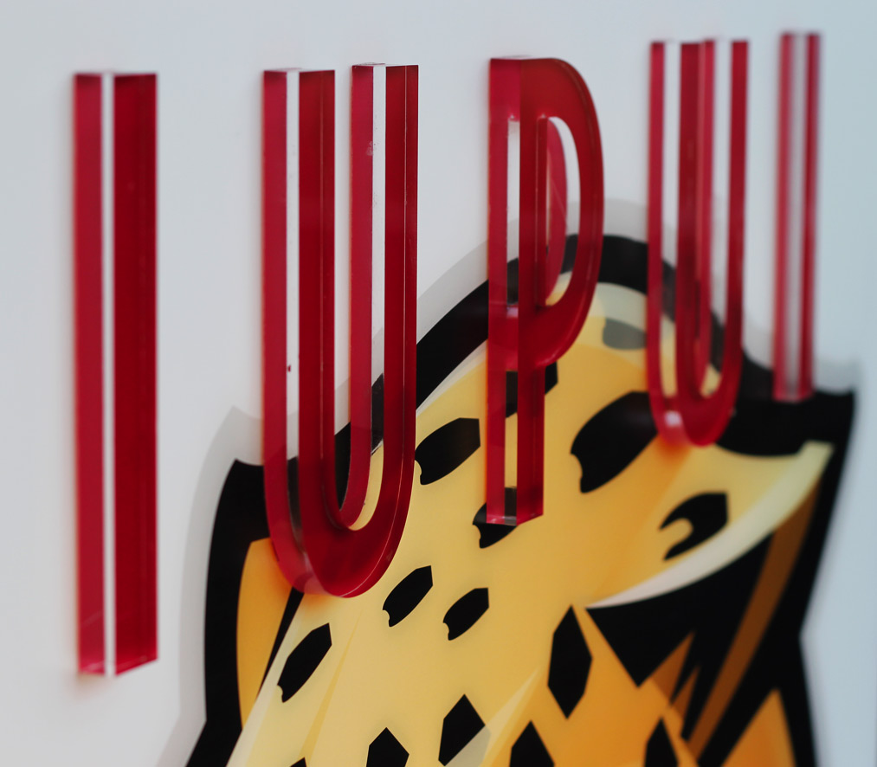
IUPUI Climate Survey 2014
Anne Mitchell, Director of Survey Research and Evaluation; Institutional Research & Decision Support
Robbie Janik, Assistant Director of Survey Research and Evaluation; Institutional Research and Decision Support
Karen Dace, Vice Chancellor, Diversity, Equity and Inclusion

Slide 2
Methodology
Purpose: to measure campus climate indicators in order to better understand faculty, staff, and students’ experiences on the IUPUI campus / expand definition of diversity
Invitations sent to every…
Full-time faculty member
Full-time staff member
Student enrolled in Fall 2014

Slide 3
Participant Characteristics
 | Faculty | Staff | Undergraduate Students | Graduate Students
Men | 52% | 28% | 37% | 41%
Women | 48% | 72% | 63% | 59%
White | 71% | 78% | 72% | 59%
Black | 6% | 11% | 9% | 6%
Latino | 5% | 4% | 7% | 5%
Asian | 13% | 2% | 5% | 21%
Other | 5% | 5% | 7% | 9%
LGBTQ+ | 8% | 8% | 14% | 10%
Non-LGBTQ+ | 92% | 92% | 86% | 90%
With Disability | 4% | 5% | 5% | 4%
No Disability | 96% | 95% | 95% | 96%
Christian | 51% | 72% | 61% | 48%
Non-Christian Religious | 11% | 4% | 7% | 19%
No Religious Affiliation | 38% | 24% | 33% | 34%
Conservative | 14% | 25% | 25% | 17%
Moderate | 33% | 41% | 45% | 39%
Liberal | 53% | 34% | 30% | 44%
n | 1052 | 1832 | 2535 | 972
Response rate | 33% | 44% | 12% | 16%

Slide 4
Asking Demographics
Gender: binary (woman/man)
Do you consider yourself to be transgender or gender non-conforming?
Sexual orientation: Gay, lesbian, bisexual, heterosexual, queer/pansexual/something else
Race/ethnicity: Check all that apply – Black, Latino, American Indian/Alaskan Native, Asian, Middle Eastern, Native Hawaiian/Pacific Islander, Other Specify
Religion: Number of religions listed, if Christian checked – opened up to specific Christian denominations
Political ideology: Very liberal to Very conservative scale

Slide 5
Overall Campus Environment
Percentage who agree with… | Faculty | Staff | Undergraduate Students | Graduate Students
I feel free to be myself at IUPUI | 81% | 82% | 95% | 94%
At IUPUI I sometimes fear speaking up for what I think | 39% | 40% | 27% | 25%
I feel safe on campus | 90% | 91% | 85% | 83%
There are a lot of people like me on campus | 74% | 80%*** | 72% | 73%
IUPUI has a commitment to diversity | 90% | 93%** | 96% | 92%***
IUPUI places too much emphasis on diversity | 23% | 29%*** | 28% | 24%*
IUPUI has diverse faculty and staff | 68% | 82%*** | 90% | 83%***
IUPUI has a diverse student population | 84% | 93%*** | 96% | 90%***
IUPUI accurately reflects diversity in publications | 79% | 85%*** | 89% | 84%***
IUPUI has a lot of tension around diversity issues | 22% | 22% | 13% | 13%
N | 1052 | 1832 | 2532 | 972
***p<.001; **p<.01; *p<.05

Slide 6
Campus Environment
Campus environment indicators differ by group
Patterns hold for faculty/staff and students – although the these differences are less pronounced for students
Intersecting statuses
Notes:
Name a few significant differences here

Slide 7
Overall Campus Environment
Percentage who agree with… | White Women Faculty | Black Women Faculty | Latina Faculty | Other Women Faculty
I feel free to be myself at IUPUI | 81% | 67% | 92% | 84%
At IUPUI I sometimes fear speaking up for what I think | 45% | 43% | 50% | 40%
I feel safe on campus | 84% | 80% | 88% | 90%
There are a lot of people like me on campus | 77% | 20% | 67% | 81%
IUPUI has a commitment to diversity | 92% | 61% | 83% | 84%
IUPUI places too much emphasis on diversity | 17% | 7% | 8% | 18%
IUPUI has diverse faculty and staff | 62% | 28% | 58% | 60%
IUPUI has a diverse student population | 83% | 63% | 71% | 83%
IUPUI accurately reflects diversity in publications | 76% | 57% | 74% | 73%
IUPUI has a lot of tension around diversity issues | 22% | 43% | 38% | 27%
It’s difficult to move up in my career | 54% | 59% | 63% | 56%
N | 339 | 30 | 24 | 57

Slide 8
Bias/Harassment/Discrimination
Faculty / Staff
Students
37% of women faculty (20% of women staff)
29% of faculty/staff of color (44% of black faculty/staff)
29% of LGBTQ+ faculty/staff
30% of faculty/staff reporting a disability
13% of women
18% of students of color
16% of sexual minorities / 29% transgender students
23% of students reporting a disability

Slide 9
Bias/Harassment/Discrimination
If you experienced bias/harassment/ discrimination, please describe one incident without using names.
1,634 total responses
Bias/Harassment/Discrimination differs based on statuses
Verbal comments are the most common means in which individuals experience bias regardless of status

Slide 10
Bias/Harassment/Discrimination
Gender
Sexual/street harassment
Assumptions regarding women’s roles
Race/ethnicity
Assumptions regarding quality of work
Access and representation
Sexual orientation / Gender identity
Name-calling / Jokes / Misgendering
Backlash regarding inclusion
Ability Status
Attitudes toward accessing services
Religion, Politics, Age, Citizenship, Language

Slide 11
Conclusion s
Overall, IUPUI faculty, staff, and students rate the campus environment positively
They feel safe, feel free to be themselves, and agree that IUPUI has a commitment to diversity.
Campus environment differs across groups
Understanding climate is difficult at an institutional level

Slide 12
Steps taken…
Series of meetings with decision makers
Deans, Vice Chancellors, HR, Faculty Development, Affinity Group Leaders
Provided resources that aligned with climate concerns and could be used for planning purposes
Climate Survey data use
Diversity Plans
Townhalls on Diversity Concerns
Programming out of Faculty/Staff councils and various offices
LGBTQ+ Center creation

Slide 13
Contact Information:
Anne Mitchell: amitch29@iupui.edu
Robbie Janik: rjanikii@iupui.edu
Vice Chancellor Karen Dace: kdace@iupui.edu
IRDS Website: Campus Climate

